Slide 1


RAMNIRANJAN JHUNJHUNWALA COLLEGE
GHATKOPAR (WEST)
PRESENTATION BY:
SAPANA GUPTA.
JYOTI SHUKLA.

Slide 2


Comparative study of smartphone usage during lockdown and post-lockdown.

Slide 3
INTRODUCTION:
The COVID-19 pandemic has tightened the grip smartphones exercise on users, and this is starting to have a negative impact on the mental and physical health of users, with a majority worrying about their smartphone addiction.
Covid-19 also acted as a catalyst for digital adoption in school and college education system .
Students mention that they use smartphones for communication, socializing, entertainment, reading and for finding information for their daily information needs.
Parents and children are spending more time on various screens at home which is seriously affecting their health and now days that students are making excessive use of their mobile phones during the lockdown.
Notes:
Introduced

Slide 4
OBJECTIVES:
To study the significant difference between average number of hours spent on smartphone during lockdown and post-lockdown.
To study the difference between number of hours spent in online lectures v/s in offline lectures.
Is there any association between age and frequency with which they use the internet.

Slide 5
METHODOLOGY:
Data was collected through questionnaire which was sent to students of all streams via Whatsapp , email, etc.
After the data collection ,we coded the data into excel format .
The tool we used for data analytics is Microsoft excel.
Further for data analysis we used :-
a. T-test :paired for two sample means : used to test whether
the mean difference between pairs of measurements is zero or not.
b. T-test : assuming equal variances :is used to test data to see if there
is statistical significance or if the results may have occurred randomly.
c. Chi- square test :used to compare observed results with expected results.

Slide 6
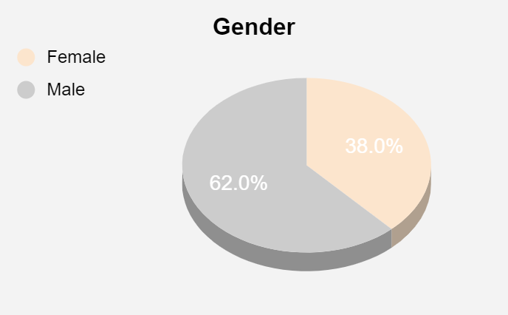
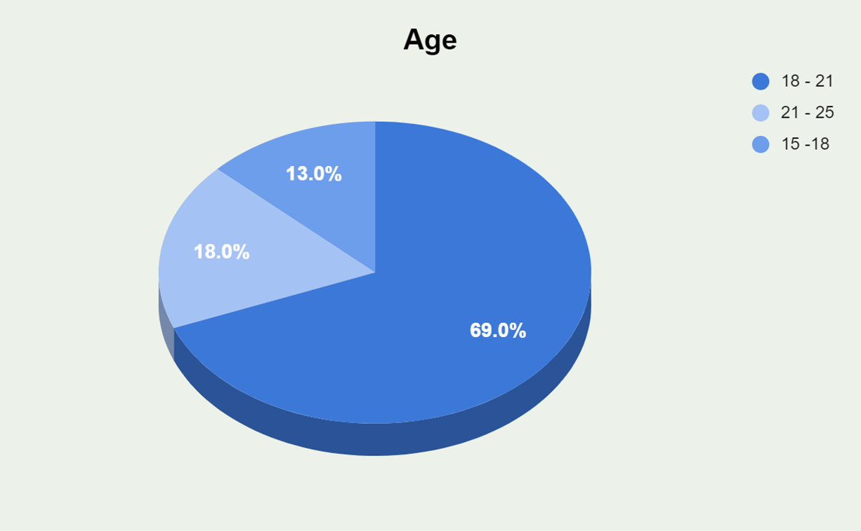
ANALYSIS OF DATA

Slide 7
Average number of hours :-
6-8(Lockdown),4-6(Post-lockdown)
Average number of hours:- 0-2 for both

Slide 8
Average number of hours :-
4-6 for both
On an average is :- 3(online) ,4(offline)

Slide 9
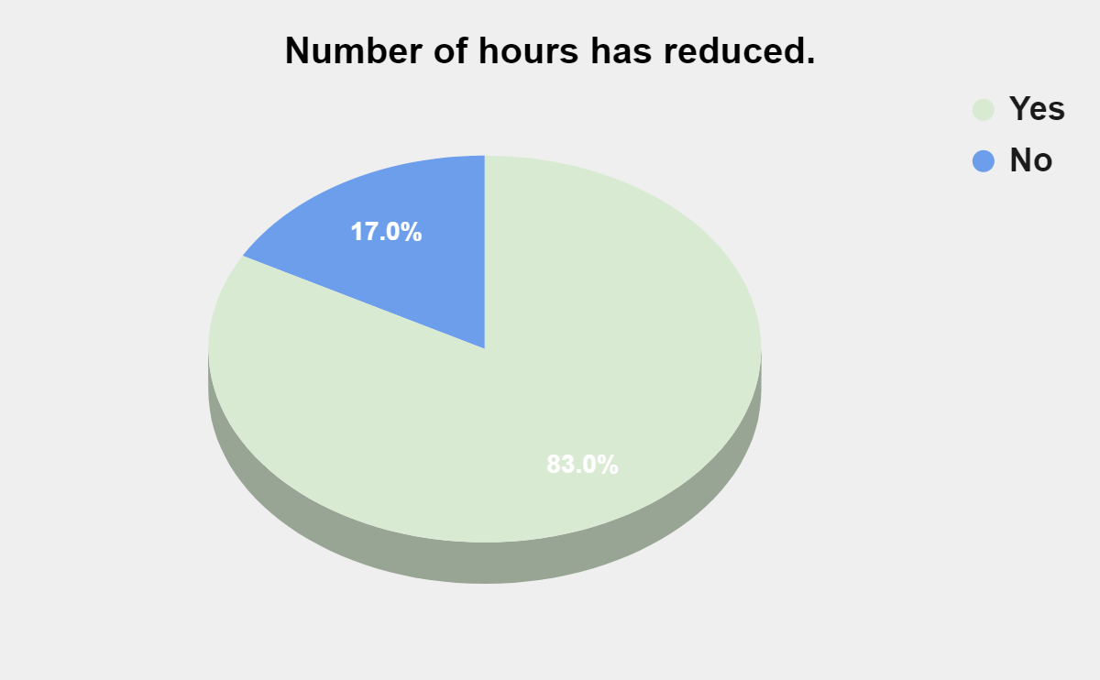
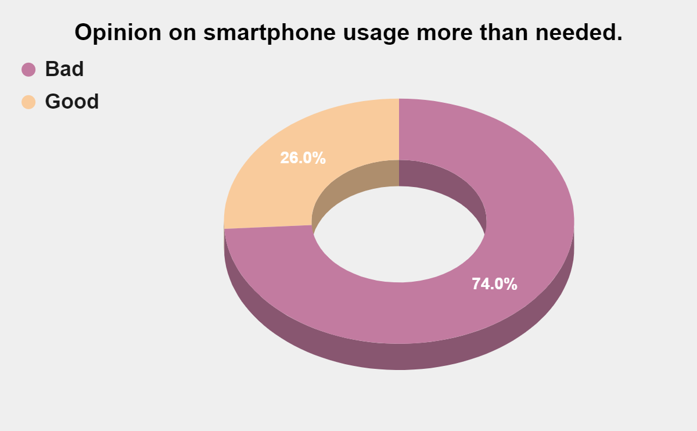
OPINION ON SMARTPHONE USAGE:-

Slide 10
TO STUDY SIGNIFICANCE DIFFERENCE BETWEEN AVERAGE NUMBER OF HOURS SPENT ON MOBILE PHONE DURING LOCKDOWN AND POST-LOCKDOWN. Ho: There is no significant difference between the average number of hours spent on mobile phone during lockdown and post-lockdown. H1: Not Ho.
t-Test: Paired Two Sample for Means
 | How many hours do you spend on your mobile phone during ? [Lockdown] | How many hours do you spend on your mobile phone during ? [post-Lockdown]
Mean | 6.79 | 5.58
Variance | 2.692828283 | 1.801616162
Observations | 100 | 100
t Stat | 8.143063521
P(T<=t) two-tail | 1.1841E-12
t Critical two-tail | 1.984216952
mean difference | 1.21
S.D difference | 0.298741
standard error of difference | 0.029874
t alpha half 90% α | 1.98421
Conclusion | P-value is < α = 0.05
 | Therefore , we reject Ho
 | Therefore there is significant difference between the average number of hours spent on mobile phone during lockdown and post-lockdown.

Slide 11
TO STUDY THE DIFFERENCE BETWEEN NUMBER OF HOURS SPENT IN ONLINE LECTURES V/S IN OFFLINE LECTURES.
t-Test: Two-Sample Assuming Equal Variances
 | How many hours do you spend in ? [online lectures] | How many hours do you spend in ? [ offline lectures]
Mean | 5.85 | 5.82
Variance | 0.613636364 | 0.633939394
Observations | 100 | 100
t Stat | 0.268588733
P(T<=t) two-tail | 0.788525822
t Critical two-tail | 1.972017478
Ho: Students spent more number of hours in online lectures than in offline lectures.
H1: Not Ho.
P-value = 0.78852 > α = 0.05
Conclusion:- We do not reject Ho.
Therefore, students spent more number of hours in online
lectures than in offline lectures.

Slide 12
IS THERE ANY ASSOCIATION BETWEEN AGE AND FREQUENCY WITH WHICH THEY USE THE INTERNET Chi-square test :- Observed frequency:- Expected frequency:-
Row Labels | No | Yes | Grand Total
1 | 1 | 12 | 13
2 | 14 | 124 | 138
3 | 6 | 48 | 54
Grand Total | 21 | 184 | 205
Row Labels | No | Yes | Grand Total
1 | 1.331707317 | 11.668293 | 13
2 | 14.13658537 | 123.86341 | 138
3 | 5.531707317 | 48.468293 | 54
Grand Total | 21 | 184 | 205
Ho: there is no significant association between age and the frequency with which they use the internet.
p<0.05 | Reject Ho
p>0.05 | Do not reject Ho
P-value | 0.933470635
Conclusion | 0.9334706 > 0.05
 | We do not reject Ho.
 | Therefore, there is no association between age and the frequency with which they use the internet.
Notes:
+

Slide 13
Conclusions:-
Students spent more number of hours in online lectures then in offline lectures.
There is significant difference between the average number of hours spent on mobile phone during lockdown and post-lockdown.
People also agree that using smartphone more than needed is not a good thing.
There is no association between age and the frequency with which they use the internet.
Number of hours has also reduced since the lockdown has lifted .

Slide 14


